Slide 1
Power BI DAX in a Day
REMOVE THIS COMMENT BEFORE TEACHING
Enter your name and company
August 2021 BETA release
Brandon Campbell, MCIS, MCT, MCP
Sr. Cloud Solution Architect-Engineer | Manufacturing
Microsoft

Slide 2
Instructor introduction
Brandon Campbell
Senior Cloud Solution Architect-Engineer in Manufacturing OU at Microsoft
Masters in Information Systems and Business Intelligence
Certificates in Data Science, Data Analysis, Azure Services, DevOps
BETA version
Notes:
To prepare a classroom presentation, please enter your you and bio details.

Slide 3
Course aim
Describe Power BI data models
Introduce Data Analysis Expressions (DAX)
Learn the calculation basics
Define common business calculations
BETA version

Slide 4
Course aim
Prerequisites
This course has been designed specifically for experienced model developers
It is recommended that you experience work with Power BI Desktop to create data models
BETA version

Slide 5
Course modules
01: Introduce Data Models
02: Write DAX Formulas
03: Define Calculated Tables and Columns
04: Define Measures
05: Use DAX Iterator Functions
06: Modify Filter Context
07: Use DAX Time Intelligence Functions
BETA version

Slide 6

Labs
Scenario
The labs are based on the sales activities of the fictitious Adventure Works company
The Adventure Works company:
Represents a bicycle manufacturer that sells bicycles and accessories to global markets
Accumulates operational data in an Azure SQL Database
Needs to explore and discover deeper insight from their data
In the labs, as their data modeler author, you will enhance an existing model with calculations

Slide 7
Agenda (times are approximate and will be fluid with the class)
Morning
09:00 AM – 09:15 AM | Introduction
09:15 AM – 09:45 AM | Module 01 Introduction to Data Models
09:45 AM –10:30 AM | Module 02 Write DAX formulas
10:30 AM – 10:50 AM | Lab 02
10:50 AM – 11:00 AM | Break
11:00 AM – 11:20 AM | Module 03 Define Calculated Tables and Columns
11:20 AM – 11:30 AM | Lab 03
11:30 AM – 12:00 PM | Module 04 Define Measures
12:00- 12:20 | Lab 04
12:20 PM – 01:00 PM | Break for lunch
Afternoon
01:00 PM – 01:30 PM | Module 05
01:30 PM – 01:50 PM | Lab 05
01:50 PM – 02:30 PM | Module 06
02:30 PM – 02:50 PM | Lab 06
02:50 PM – 03:00 PM | Break
03:00 PM – 03:30 PM | Module 07
03:30 PM – 03:50 PM | Lab 07
03:50 PM – 04:15 PM | Summary Questions and survey
Notes:
Key message: in this workshop we will cover the breath of Power BI capabilities.
After analyzing and visualizing the dataset provided in the workshop, you will use these skills to get started on your own data.

Slide 8
Labs
2: Write DAX formulas for Power BI
3: Add Calculated table and Columns
4: Add measures to Power BI Desktop models
5: Use DAX iterator functions in Power BI Desktop models
6: Modify DAX filter context in Power BI Desktop Models
7: Use DAX Time Intelligence functions in Power BI Desktop models

Slide 9
Labs
PC setup
You will need a Windows PC
Windows 10, or later
The following software must be installed:
Power BI Desktop, latest version
from the Microsoft Store https://go.microsoft.com/fwlink/?linkid=2135345 or from the download center https://go.microsoft.com/fwlink/?linkid=2135519
Notes:
If students are going to do the labs, explain that students will need to meet the classroom setup requirements, as described in this slide. Preferably they did the setup prior to starting class.

Slide 10
Labs
Get setup
Please download the Attendee content:
https://aka.ms/DAXIAD
Setup instructions:
Download the zip file locally
Edit the file properties, and “unblock”
Extract the file contents to your file system
The lab documents will refer to this location as <CourseFolder>
The presentation is available as a PDF in the folder
The reports you are starting each lab, are available in the folder with solutions to previous labs
Notes:
Students must download and install the self-study kit. Preferably they did the setup prior to starting class. Full details and discussion about the self-study kit is found in the online documentation.

Slide 11
Feedback
Your feedback is important to help us understand how well we meet your needs, and to improve the experience for future attendees
On completion of the class, you will be asked to complete a post training survey
If you must leave the class early, please request the survey URL in advance
BETA version
Notes:
Emphasize the need to communicate feedback, both during the class and after the class completes.

Slide 12
Resources
Use DAX in Power BI Desktop
This Microsoft learning path introduces Data Analysis Expressions (DAX) and provides you with foundational skills required to enhance data models with calculations
https://docs.microsoft.com/learn/paths/dax-power-bi/
DAX videos
https://docs.microsoft.com/dax/dax-learn-videos
Data Analysis Expressions (DAX) Reference
https://docs.microsoft.com/dax/
Learn path for individual study:
Use DAX in Power BI Desktop - Learn | Microsoft Docs

Slide 13
Questions?

Slide 14
Power BI DAX in a Day
Module 01
Introduce Data Models

Slide 15
Module outline
01: Introduce Data Models
Data model fundamentals
Star schema design
Define analytic query
Configure report visuals
BETA version
Notes:
This module introduces the basics of data models. The topics covered in this module are essential to support the DAX theory covered in later modules.

Slide 16
Data model fundamentals
A Data model is a query-able data resource optimized for analytics
Microsoft data models can be queried using DAX or MDX
It can also be described as a semantic model, or simply a model
BETA version

Slide 17
Data model fundamentals
Tabular model
A Tabular model comprises one or more tables
It possibly defines relationships, hierarchies, hierarchy levels, and calculations.
All Power BI models are tabular
BETA version

Slide 18
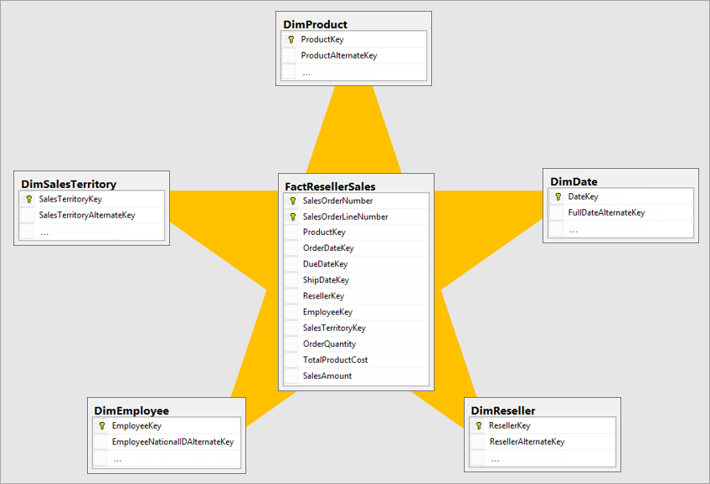
Star schema design
Fact tables
Dimension tables
For a detailed explanation of star schema, read the Understand star schema and the importance for Power BI article
BETA version

Slide 19
Star schema design
Fact tables
A Fact table stores an accumulation of rows
It records a specific business activity, for example:
Sales transactions
Stock movements
Daily currency exchange rates
BETA version
Notes:
The role of a fact table is to store an accumulation of rows that represent observations or events that record a specific business activity. For example, events that are stored in a sales fact table could be sales orders and the order lines.
You could also use a fact table to record stock movements, stock balances, or daily currency exchange rates.
Generally, fact tables contain numerous rows. As time passes, fact table rows accumulate.
In analytic queries (which will be defined later in this module), fact table data is summarized to produce values like sales and quantity.
You can have more than 1 Fact table in a model

Slide 20
Star schema design
Dimension tables
A Dimension table describes a business entity
It is designed to filter and group related fact table data, for example:
Date
Product
Geography
People (employees or customers)
Each dimension table must have a unique column (key) so a relationship can be created to the fact tables
BETA version
Notes:
Dimension tables describe your business entities, which commonly represent people, places, products, or concepts.
A date dimension table, which contains one row for each date, is a common example of a concept dimension table.
The columns in dimension tables allow filtering and grouping of fact table data.
Each dimension table must have a unique column, which is referred to as its key column.
A unique column doesn't contain duplicate values and it should never have missing values.
In a product dimension table, the column could be named ProductKey or ProductID.
Likely, additional columns will store descriptive values, like the product name, subcategory, category, color, and so on.
In analytic queries, these columns are used to filter and group data

Slide 21
Star schema design
Compare table types
 | Dimension table | Fact table
Model purpose | Stores business entities | Stores events or observations
Table structure | Includes a key column and descriptive columns for filtering and grouping | Includes dimension key columns and numeric measure columns that can be summarized
Data volume | Typically, contains fewer rows (relative to fact tables) | Can contain numerous rows
Query purpose | To filter and group | To summarize
Dimension tables:
Store business entities
Include a key column and descriptive columns for filtering and grouping
Typically, contain fewer rows (relative to fact tables)
Are used by visuals to filter and group
Fact tables:
Store events or observations
Include dimension key columns and numeric measure columns that can be summarized
Can contain numerous rows
Are used by visuals to summarize
BETA version
Notes:
The following table to revise and compare the characteristics of fact and dimension tables.

Slide 22
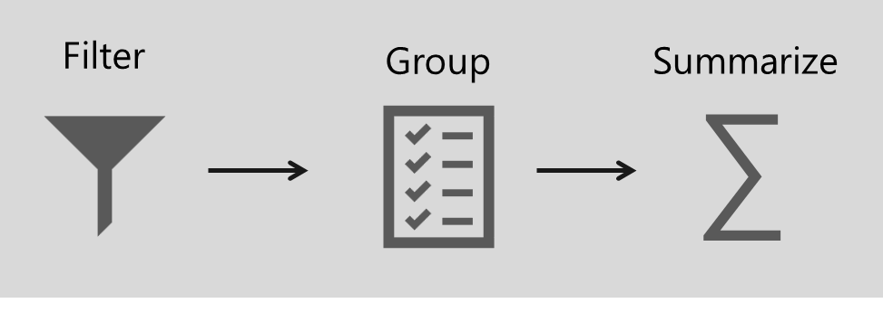
Define analytic query
An Analytic query retrieves data from a data model
It has three distinct phases:
Filter
Group
Summarize
BETA version
Notes:
An analytic query is a query that produces a result from a data model.
Each Power BI visual, in the background, submits an analytic query to Power BI to query the model.
The analytic query is written as a Data Analysis Expressions (DAX) query statement.
However, you don't need to write a native DAX statement; you only need to configure report visuals by mapping dataset fields.

Slide 23
Define analytic query
1: Filter phase
The Filter phase targets data of relevance
It can be applied to:
Report
Page
Visual
Also applied using row-level security (RLS)
Visuals can inherit filters, or they can be applied directly
BETA version
Notes:
Filtering, or slicing, targets the data of relevance.
In Power BI reports, filters can be applied to three different scopes:
report,
page,
or visual.
Filtering is also applied in the background when row-level security (RLS) is enforced.
Each report visual can inherit filters or have filters directly applied to it.

Slide 24
Define analytic query
2: Group phase
The Group phase divides query results into groups
It often groups by entity (column) in dimension table
Common examples of grouping:
Year, Month, or Day
Product category
Country or region
BETA version
Notes:
Grouping, or dicing, divides query results into groups.

Slide 25
Define analytic query
3: Summarize
The Summarize phase produces a single value
Typically, numeric columns are summarized
Common examples of summarizing:
Sum
Count
Average
Min and Max
BETA version
Notes:
Summarizing produces a single value result.
Typically, numeric columns are summarized by using summarization methods (sum, count, and many others).
These methods are simple summarizations.
More complex summarizations, like a percent of grand total, can be achieved by defining measures that are written in DAX
Not all analytic queries need to filter, group, and summarize:
Commonly, report visuals are filtered, perhaps by a time period or geographic location.
Grouping is optional. For example, a card visual, which is used to display a single value, isn't concerned with grouping.
Typically, report visuals summarize. One notable exception, however, is the slicer visual, which isn't concerned with summarization.

Slide 26
Configure report visuals
Select a visualization type
Map dataset fields
Configure mapped fields (rename etc.)
Apply format options
BETA version
Notes:
Report authors produce report designs by adding report visuals and other elements to pages.
Other elements include text boxes, buttons, shapes, and images.
Each of these elements is configured independently of dataset fields.
At design time, adding and configuring a report visual involves the following methodology:
Select a visual type, like a bar chart.
Map dataset fields, which are displayed in the Fields pane, to the visual field wells. For a bar chart, the wells are Axis, Legend, Values, and Tooltips.
Configure mapped fields. It's possible to rename mapped fields or toggle the field to summarize or not summarize. If the field summarizes, you can select the summarization method.
Apply format options, like axis properties, data labels, and many others.

Slide 27

Configure report visuals
Fields
Fields is a collective term for columns, hierarchy levels, and measures
They can be used in the following phases of an analytic query
Field type | Filter | Group | Summarize
Column
Hierarchy level
Measure
Columns can be used to Filter, Group, or Summarize
Hierarchy levels can be used to Filter or Group
Measures can be used to Filter or Summarize
BETA version
Notes:
Use columns to filter, group, and summarize column values.
Summarizing numeric columns is common, and it can be done by using sum, count, distinct count, minimum, maximum, average, median, standard deviation, and variance.
You can also summarize text columns by using first (alphabetic order), last, count, and distinct count.
Additionally, you can summarize date columns by using earliest, latest, count, and distinct count.
At design time, the data modeler can set the column default summarization property.
This property can be set to any of the supported summarization types or to Do not summarize.
The latter option means that the column, by default, is only to be used to group.
If your data model has a numeric column that stores year values, it would be appropriate to set its default summarization to Do not summarize because the column will likely be used only for grouping or filtering, and that numeric summarization of years, like an average, doesn't produce a meaningful result.

Slide 28
Configure report visuals
Hierarchy levels
Hierarchy levels are based on columns
They can be used to filter and group—but not to summarize
BETA version
Notes:
While hierarchy levels are based on columns, they can be used to filter and group but not to summarize.
Report authors can summarize the column that the hierarchy level is based on, provided that it's visible in the Fields pane.

Slide 29
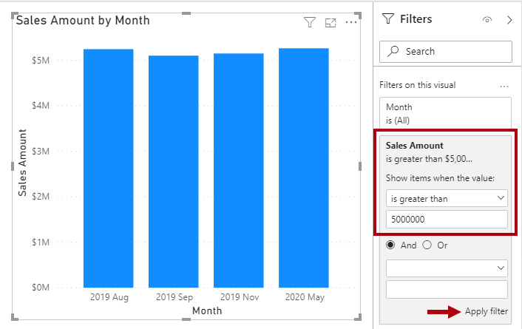
Configure report visuals
Measures
Measures are designed to summarize
They can be used to filter
However, they filter groups by the measure—for example, show only months where the sales amount (summarization) is greater than $5M
They cannot be used to group data
BETA version
Notes:
Measures are designed to summarize model data; they can't be used to group data.
However, measures can be used to filter data in one special case: to use a measure to filter a visual when the visual displays the measure and the filter is a visual-level filter (so, not a report or page-level filter).
When used in this way, a measure filter is applied after the analytic query has summarized data.
This process is done to eliminate groups where the measure filter condition is not true. (For those who are familiar with SQL syntax, a measure that used to filter a visual is like the HAVING clause in a SELECT statement.)
The following figure shows the stacked column visual adjusted to display groups (months) when sales amounts exceed $5 million.
This adjustment is done in the Filters pane by applying a filter to the Sales Amount field: Configure the filter to show items when the value is greater than 5000000.
Remember to select Apply filter, which is located in the lower-right corner of the card.
Notice that only four groups (months) have sales amounts exceeding $5 million.

Slide 30
Resources
Learn: Describe Power BI Desktop models
https://docs.microsoft.com/learn/modules/dax-power-bi-models/
Docs: DAX overview
https://docs.microsoft.com/dax/dax-overview
Docs: Understand star schema and the importance for Power BI
https://docs.microsoft.com/power-bi/guidance/star-schema

Slide 31
Power BI DAX in a Day
Knowledge Check 01
https://aka.ms/DAXIADKnowCheck01
Notes:
For instructor, option 01 is to use the link above for the knowledge check questions
Option 02 is to use the Knowledge check in the appendix to the slides

Slide 32
Questions?

Slide 33
Power BI DAX in a Day
Module 02
Write DAX Formulas

Slide 34
Module outline
02: Write DAX Formulas
Describe DAX calculation types
Write DAX formulas
Describe DAX data types
Work with DAX functions
Use DAX operators
Notes:
This module covers the basics on how to write DAX formulas.

Slide 35
Describe DAX calculation types
DAX can be used to create three types of calculations:
Calculated table
Calculated column
Measure
DAX can also be used to define row-level security (RLS) rules
RLS is not in scope for this course
Notes:
By using Data Analysis Expressions (DAX), you can add three types of calculations to your data model:
NOTE:
DAX can also be used to define row-level security (RLS) rules, which are expressions that enforce filters over model tables.
However, rules aren't considered to be model calculations so they're out of scope for this module. For more information, see Row-level security (RLS) with Power BI .

Slide 36
Describe DAX calculation types
Calculated table
A Calculated table adds a new table to the model
Examples:
Date tables
Role-playing dimensions
What-if analysis
Each calculated table will increase the storage size of the model
Notes:
You can write a DAX formula to add a calculated table to your model.
The formula can
duplicate or transform existing model data, or
create a series of data, to produce a new table.
Calculated table data is always imported into your model, so it increases the model storage size and can prolong data refresh durations.
A calculated table can't connect to external data; you need to use Power Query to accomplish that task.

Slide 37
Describe DAX calculation types
Calculated table » Date table
A Date table is required to work with Time Intelligence functions
It can be created using the CALENDAR or CALENDARAUTO functions
Notes:
Date tables are required to apply special time filters known as time intelligence.
A family of DAX functions, known as time-intelligence functions, only work correctly when a date table is set up.
When your source data doesn't include a date table, you can create one as calculated tables by using the CALENDAR or CALENDARAUTO DAX functions.

Slide 38
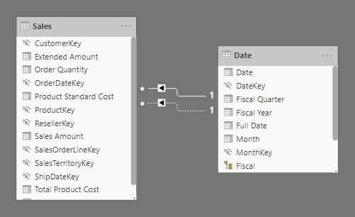
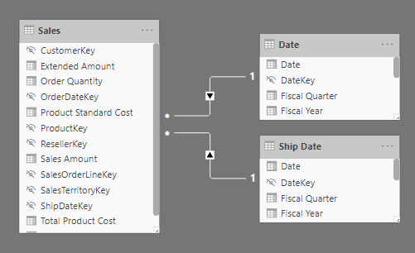
Describe DAX calculation types
Calculated table » Role-playing dimensions
Inactive relationships
Duplicate tables with active relationships
Notes:
When two model tables have multiple relationships, it could be because your model has a role-playing dimension.
For example, if you have a table named Sales that includes two date columns,
OrderDateKey and
ShipDateKey,
both columns are related to the Date column in the Date table.
In this case, the Date table is described as a role-playing dimension because it could play the role of order date or ship date.
Microsoft Power BI models only allow one active relationship between tables, which in the model diagram is indicated as a solid line.
The active relationship is used by default to propagate filters, which in this case would be from the Date table to the OrderDateKey column in the Sales table.
Any remaining relationships between the two tables are inactive.
In a model diagram, the relationships are represented as dashed lines. Inactive relationships are only used when they're expressly requested in a calculated formula by using the USERELATIONSHIP DAX function.
Perhaps a better model design could have two date tables, each with an active relationship to the Sales table.
Thus, report users can filter by order date or ship date, or both at the same time. A calculated table can duplicate the Date table data to create the Ship Date table.

Slide 39
Describe DAX calculation types
Calculated table » What-if analysis
Power BI Desktop supports creating What-if Parameters
It automates the creation of a calculated table with a generated series of rows, and a measure to retrieve the currently selected value
Commonly used in what-if analysis
Typically, these tables remain disconnected (not related to other tables)
Examples: Currency conversion, forecasting scenarios
Notes:
Power BI Desktop supports a feature called What-if parameters .
When you create a what-if parameter, a calculated table is automatically added to your model.
What-if parameters allow report users to select or filter by values that are stored in the calculated table.
Measure formulas can use selected value(s) in a meaningful way.
For example, a what-if parameter could allow the report user to select a hypothetical currency exchange rate, and a measure could divide revenue values (in a local currency) by the selected rate.
Notably, what-if calculated tables aren't related to other model tables because they're not used to propagate filters. For this reason, they're sometimes called disconnected tables.

Slide 40
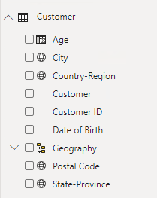
Describe DAX calculation types
Calculated column
A Calculated column adds a new column to a table
A formula is evaluated for each row in table
The formula must return a single value
It is only evaluated when model is refreshed*
It increase storage size of the model*
*Except when added to a DirectQuery table
Notes:
You can write a DAX formula to add a calculated column to any table in your model.
The formula is evaluated for each table row and it returns a single value.
When added to an Import storage mode table, the formula is evaluated when the data model is refreshed and it increases the storage size of your model.
When added to a DirectQuery storage mode table, the formula is evaluated by the underlying source database when the table is queried.
In the Fields pane, calculated columns are enhanced with a special icon.
The following example shows a single calculated column in the Customer table called Age.

Slide 41
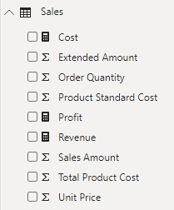
Describe DAX calculation types
Measures
A Measure summarizes model data
The formula must return a single value
It is evaluated at query-time
Results are never stored in the model
Notes:
You can write a DAX formula to add a measure to any table in your model.
The formula is concerned with achieving summarization over model data.
Similar to a calculated column, the formula must return a single value.
Unlike calculated columns, which are evaluated at data refresh time, measures are evaluated at query time and their results are never stored in the model.
In the Fields pane, measures are shown with the calculator icon. The following example shows three measures in the Sales table: Cost, Profit, and Revenue.

Slide 42
Write DAX formulas
Each model calculation type is defined by its name, followed by the equals symbol (=), which is then followed by a DAX formula
<calculation name> = <DAX formula>
Ship Date = 'Date'
Notes:
Each model calculation type, calculated table, calculated column, or measure is defined by its name, followed by the equals symbol (=), which is then followed by a DAX formula.
Use the following template to create a model calculation:

Slide 43
Write DAX formulas
A DAX formula consists of expressions that return a result
The result is either a table object or a scalar value
Topics:
DAX functions
DAX operators
References to model objects
Constant values
DAX variables
Whitespace
Notes:
A DAX formula consists of expressions that return a result.
The result is either a table object or a scalar value.
Calculated table formulas must return a table object;
calculated column and measure formulas must return a scalar or single value.
TIP
When entering DAX formulas in Power BI Desktop, you have the benefit of IntelliSense.
IntelliSense is a code-completion aid that lists functions and model resources.
When you select a DAX function, it also provides you with a definition and description.
We recommend that you use IntelliSense to help you quickly build accurate formulas.

Slide 44
Write DAX formulas
DAX functions
DAX is a functional language
Functions can use parameters
Functions can be nested
Most functions return an object (scalar value, column, or table)
Many common functions will be introduced in this course
Notes:
Similar to Microsoft Excel, DAX is a functional language;
formulas rely on DAX functions to accomplish specific goals. Typically, functions have arguments that allow passing in variables.
Formulas can use many function calls and will often nest functions within other functions.
In a formula, function names must be followed by parentheses. Within the parentheses, variables are passed in.
[Note]
Some functions don't take arguments, or arguments might be optional.
Working with DAX functions is described later in this module.

Slide 45
Write DAX formulas
DAX operators
Formulas also rely on DAX operators, which can perform arithmetic calculations, compare values, work with strings, or test conditions
Operators can:
Perform arithmetic calculations
Compare values
Work with strings
Test conditions
DAX operators are described later in this module
Notes:
Formulas also rely on DAX operators, which can perform arithmetic calculations, compare values, work with strings, or test conditions.
DAX operators are described in more detail later in this module.

Slide 46
Write DAX formulas
Reference model objects
There are only three types of model objects that are referenced by DAX formulas:
Tables
Columns
Measures
It is not possible to reference a hierarchy level
Instead, use the column that the level is based on
Notes:
Formulas can only refer to three types of model objects: tables, columns, or measures.
A formula can't refer to a hierarchy or a hierarchy level. (Recall that a hierarchy level is based on a column, so your formula can refer to a hierarchy level's column.)

Slide 47
Write DAX formulas
Reference model objects » Table reference
Table references use the table name
If the table is a reserved word, it must be enclosed in single quotes
Arrival Airport = Airport
Ship Date = 'Date'
Notes:
When you are referencing a table in a formula, officially, the table name is enclosed within single quotation marks.
In the following calculated table definition, notice that the Date table is enclosed within single quotation marks.
However, single quotation marks can be omitted when both of the following conditions are true:
The table name does not include embedded spaces.
The table name is not a reserved word that is used by DAX. All DAX function names and operators are reserved words.
Date is a DAX function name, which explains why, when you are referencing a table named Date, that it must be enclosed within single quotation marks.
In the following calculated table definition [Airport], it's possible to omit the square brackets when referencing the Airport table:

Slide 48
Write DAX formulas
Reference model objects » Column reference
Column references always enclose the column name in square brackets
To improve readability and to disambiguate, precede the column name with its table name
Revenue = SUM([Sales Amount])
Revenue = SUM(Sales[Sales Amount])
Notes:
When you are referencing a column in a formula, the column name must be enclosed within square brackets.
Optionally, it can be preceded by its table name. For example, the following measure definition refers to the Sales Amount column.
[TIP]
To improve the readability of your formulas, we recommend that you always precede a column reference with its table name.
This tip helps quickly clarify if an object reference refers to a measure or column
Because column names are unique within a table but not necessarily unique within the model, you can disambiguate the column reference by preceding it with its table name.
This disambiguated column is known as a fully qualified column. Some DAX functions require passing in fully qualified columns

Slide 49
Write DAX formulas
Reference model objects » Measure reference
Measure references always enclose the measure name in square brackets
Profit = [Revenue] - [Cost]
Notes:
When you are referencing a measure in a formula, like column name references, the measure name must be enclosed within square brackets.
For example, the following measure definition refers to the Revenue and Cost measures.
If you are a DAX beginner, the fact that column and measure references are always enclosed within square brackets can cause confusion when you are trying to read a formula.
However, when you're proficient with DAX fundamentals, you'll be able to determine which type of object it is because, in DAX formulas, columns, and measures are used in different ways.
[TIP]
It's possible to precede a measure reference with its table name.
However, measures are a model-level object.
While they're assigned to a home table, it's only a cosmetic relationship to logically organize measures in the Fields pane.
Therefore, while we recommend that you always precede a column reference with its table name, the inverse is true for measures:
We recommend that you never precede a measure reference with its table name.

Slide 50
Write DAX formulas
DAX variables
Variables can be defined in an expression to make writing DAX easier
Main benefits:
Improves readability of a formula
Improves performance when an expression is used multiple times
Allows testing portions of a complex formula, by returning only a variable for review
VAR <name> = <expression> [VAR <name2>…]
RETURN <expression>
Notes:
Formulas can declare DAX variables to store results.
How and when to use DAX variables is described later in this course

Slide 51
Write DAX formulas
DAX variables » Example
Revenue YoY % = VAR RevenuePriorYear = CALCULATE( [Revenue], SAMEPERIODLASTYEAR('Date'[Date]) ) RETURN DIVIDE( [Revenue] - RevenuePriorYear, RevenuePriorYear )
Notes:
The following example shows a formula that declares a variable.
The Revenue YoY % measure definition is rewritten to declare a variable that's assigned the value of the prior year's revenue.
Notice that the RETURN clause refers to the variable twice.
This improved measure definition formula will run in at least half the time because it doesn't need to evaluate the prior year's revenue twice.

Slide 52
Write DAX formulas
Whitespace
Whitespace refers to characters that format formulas in a way that is quick and simple to understand
Whitespace characters include:
Spaces
Tabs
Carriage returns
Notes:
Whitespace refers to characters that you can use to format your formulas in a way that's quick and simple to understand.
Whitespace characters include: [shown on slide]
Whitespace is optional and it doesn't modify your formula logic or negatively impact performance.

Slide 53
Write DAX formulas
Whitespace » Usage
Use spaces between operators
Use tabs to indent nested function calls
Use carriage returns to separate function arguments
Err on side of more whitespace
Notes:
Whitespace refers to characters that you can use to format your formulas in a way that's quick and simple to understand.
Whitespace characters include: [shown on slide]
Whitespace is optional and it doesn't modify your formula logic or negatively impact performance.
We strongly recommend that you adopt a format style and apply it consistently, and consider the following recommendations:
Use spaces between operators.
Use tabs to indent nested function calls.
Use carriage returns to separate function arguments, especially when it's too long to fit on a single line.
Formatting in this way makes it simpler to troubleshoot, especially when the formula is missing a parenthesis.
Err on the side of too much whitespace than too little.

Slide 54
Write DAX formulas
Whitespace » Example
Revenue YoY % = DIVIDE([Revenue] - CALCULATE([Revenue], SAMEPERIODLASTYEAR ('Date'[Date])), CALCULATE ([Revenue], SAMEPERIODLASTYEAR ('Date'[Date])))
Revenue YoY % = DIVIDE( [Revenue] - CALCULATE( [Revenue], SAMEPERIODLASTYEAR ('Date'[Date]) ), CALCULATE ( [Revenue], SAMEPERIODLASTYEAR ('Date'[Date]) ) )
Notes:
Consider the top measure definition that's written in a single line and that includes five DAX function calls:
[CLICK] The following example is the same measure definition but now formatted, which helps make it easier to read and understand:
Try formatting the measure on your own. Open the Adventure Works DW 2020 M02.pbix Power BI Desktop file and then, in the Fields pane, expand the Sales table and select the Revenue YoY % measure.
Use tab and carriage return characters to produce the same result as the previous example.
When you add a carriage return, remember to press the Shift+Enter shortcut keys.
This measure definition can still be improved for readability and performance, which will be explained later in this module
Tip:
An excellent formatting tool from another source that can help you format your calculations is DAX Formatter .
The tool allows you to paste in your calculation and format it.
Then, you can copy the formatted calculation to your clipboard and paste it back into Power BI Desktop.

Slide 55
Describe DAX data types
Columns have a set data type
Column types are set in Power Query or for calculated columns, they are inferred from the DAX formula
Measure data types are inferred from the DAX formula
Notes:
Data model columns have a set data type, which ensures that all column values conform to that data type.
Column data types are defined in Power Query, or in the case of calculated columns, it's inferred from the formula.
Measure data types, similar to calculated column data types, are inferred from the formula.
Model data types aren't the same as DAX data types, though a direct relationship exists between them.
The following table lists the model data types and DAX data types. Notice the supported range of values for each data type.

Slide 56
Describe DAX data types
Model data type | DAX data type | Description
Whole number | 64-bit integer | -2⁶³ through 2⁶³-1
Decimal number | 64-bit real | 8 bytes per value (64 bits!!) – Like (SQL) Float
Boolean | Boolean | TRUE or FALSE
Text | String | Unicode character string
Date | Date/time
Currency | Currency | -9.22 x 10¹⁴ to 9.22 x 10¹⁴ Limited to four decimal digits of fixed precision
N/A | BLANK | Sometimes equivalent to SQL
Notes:
Model data types aren't the same as DAX data types, though a direct relationship exists between them.
The following table lists the model data types and DAX data types. Notice the supported range of values for each data type.

Slide 57
Describe DAX data types
BLANK
DAX uses BLANK for both database NULL and for blank cells in Excel
BLANK doesn't mean zero
Perhaps it is simpler to think of it as the "absence of a value“
Two DAX functions are related to the BLANK data type:
BLANK - Returns BLANK
ISBLANK - Tests whether an expression evaluates as BLANK
Notes:
The BLANK data type deserves a special mention.
DAX uses BLANK for both database NULL and for blank cells in Excel.
BLANK doesn't mean zero.
Perhaps it might be simpler to think of it as the "absence of a value".
Two DAX functions are related to the BLANK data type: the BLANK DAX function returns BLANK, while the ISBLANK DAX function tests whether an expression evaluates to BLANK.

Slide 58
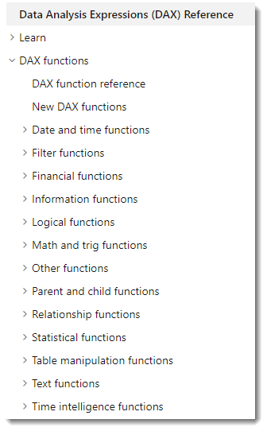
Work with DAX functions
The DAX function library consists of hundreds of functions, each designed to accomplish a specific goal
Many are similar to Excel functions
Some are specific to data modeling:
Relationship navigation
Filter context modification
Iterator
Time Intelligence
Path
Notes:
The DAX function library consists of hundreds of functions, each designed to accomplish a specific goal.
Because DAX originated with the Power Pivot add-in for Microsoft Excel 2010, over 80 functions are available that can also be found in Excel.
It was a deliberate design strategy by Microsoft to ensure that Excel users can quickly become productive with DAX.
[TIP]
To search for documentation that is related to a DAX function, in a web search, enter the keyword DAX followed by the function name.

Slide 59
Work with DAX functions
Excel-like functions
Summarization functions
SUM, COUNT, AVERAGE, MIN, MAX ….
Mathematic functions
ABS, ROUND, SQRT, LEN, LEFT, RIGHT, UPPER, DATE, YEAR, MONTH, NOW, ISNUMBER, TRUE, FALSE, AND, OR, NOT, ISERROR
Conditional logic
IF ( <logical_test>, <value_if_true> [, <value_if_false> ] )
Notes:
The following sections consider several useful functions that you might already be familiar with because they exist in Excel.
The IF DAX function tests whether a condition that is provided as the first argument is met. It returns one value if the condition is TRUE and returns the other value if the condition is FALSE. The function's syntax is:
[Tip]
A function argument is optional when documentation shows it enclosed within square brackets.
Many Excel summarization functions are available, including SUM, COUNT, AVERAGE, MIN, MAX, and many others.
The only difference is that in DAX, you would pass in a column reference, whereas in Excel, you would pass in a range of cells.
Many Excel mathematic, text, date and time, information, and logical functions are available as well.
For example, a small sample of Excel functions that are available in DAX include ABS, ROUND, SQRT, LEN, LEFT, RIGHT, UPPER, DATE, YEAR, MONTH, NOW, ISNUMBER, TRUE, FALSE, AND, OR, NOT, and IFERROR.

Slide 60
Work with DAX functions
Not found in Excel
DISTINCTCOUNT
DIVIDE
DIVIDE ( <numerator>, <denominator> [, <alternate_result>] )
Notes:
You can use the DISTINCTCOUNT DAX function to count the number of distinct values in a column.
This function is especially powerful in an analytics solution.
Consider that the count of customers is different from the count of distinct customers.
The latter doesn't count repeat customers, so the difference is "How many customers" compared with "How many different customers.“
DIVIDE
You can use the DIVIDE DAX function to achieve division.
You must pass in numerator and denominator expressions.
Optionally, you can pass in a value that represents an alternate result. The DIVIDE function's syntax is:
The DIVIDE function was designed to automatically handle division by zero cases.
If an alternate result isn't passed in, and the denominator is zero or BLANK, the function returns BLANK.
When an alternate result is passed in, it's returned instead of BLANK.
This function is convenient because it saves your expression from having to first test the denominator value.
The function is also better optimized for testing the denominator value than the IF function.
The performance gain is significant because checking for division by zero is expensive.
What's more, using the DIVIDE function results in a more concise and elegant expression.
We recommend that you use the DIVIDE function whenever the denominator is an expression that could return zero or BLANK.
In the case that the denominator is a constant value, we recommend that you use the divide operator (/), which is introduced later in this module.
In this case, the division is guaranteed to succeed, and your expression will perform better because it will avoid unnecessary testing.

Slide 61
Use DAX operators
Arithmetic operators
Operator | Description | Example
+ | Addition | 2 + 3 = 5
- | Subtraction | 5 - 3 = 2
* | Multiplication | 2 * 3 = 6
/ | Division | 6 / 3 = 2
^ | Exponentiation | 2 ^ 3 = 8
Notes:
Remember, when you are dividing two expressions, and when the denominator could return zero or BLANK, it's more efficient and safer to use the DIVIDE DAX function.

Slide 62
Use DAX operators
Comparison operators
Operator | Description | Example | Result
= | Equal To | 2 = 3 | FALSE
== | Strict equal to | [Revenue] == 0 | *
> | Greater than | 2 > 3 | FALSE
< | Less than | 2 < 3 | TRUE
>= | Greater than or equal to | 2 >= 3 | FALSE
<= | Less than or equal to | 2 <= 3 | TRUE
<> | Not equal to | 2 <> 3 | TRUE
Notes:
All comparison operators, except strict equal to (==), treat BLANK as equal to the number zero, an empty string (""), the date December 30, 1899, or FALSE.
It means that the expression [Revenue] = 0 will be TRUE when the value of [Revenue] is either zero or BLANK. In contrast, [Revenue] == 0 is TRUE only when the value of [Revenue] is zero.

Slide 63
Use DAX operators
Text concatenation
Use the ampersand (&) character to concatenate text values
DAX functions CONCATENATEX and COMBINEVALUES are also options for text concatenation
Model Color = Product[Model] & "-" & Product[Color]
Notes:
Uses & (and not + like other languages).
DAX functions CONCATENATEX and COMBINEVALUES are also options for text concatenation

Slide 64
Use DAX operators
Logical operators
Operator | Description | Example | Result
&& | Logical AND | TRUE && FALSE | FALSE
|| | Logical OR | TRUE || FALSE | TRUE
IN | Multiline OR | “A” IN {“A”, “B” “C”} | TRUE
NOT | Inverts state | NOT FALSE | TRUE
Customer[Country-Region] IN { "Australia", "New Zealand" }
Notes:
An example that uses the IN logical operator.

Slide 65
Use DAX operators
Operator precedence
Operator | Description
^ | Exponentiation
- | Sign (as in -1)
* and / | Multiplication and Division
NOT | NOT
+ and - | Addition and subtraction
& | Text concatenation
=, ==, <, >, <=, >=, <> | Comparison
Notes:
When your DAX formula includes multiple operators, DAX uses rules to determine the evaluation order, which is known as an operator precedence.
Operations are ordered according to the following table.
When the operators have equal precedence value, they are ordered from left to right.
In general, operator precedence is the same as what's found in Excel.
If you need to override the evaluation order, then group operations within parentheses.
For example, consider the following calculated column definition:

Slide 66
Use DAX operators
Operator precedence » Examples
Operation | Result
2 + 3 * 4 | 14
(2 + 3) * 4 | 20
Notes:
Top line
3 * 4 = 12 + 2 = 14
Bottom line
2 + 3 = 5 * 4 = 20
[TIP]
Remembering operator precedence rules can be challenging, especially for DAX beginners.
Consequently, we recommend that you test your formulas thoroughly.
When the formulas don't produce the correct result due to an incorrect evaluation order, you can experiment by adding parentheses to adjust the evaluation order.
You can also add parentheses to improve the readability of your form

Slide 67
Use DAX operators
Implicit conversion
Usually, DAX automatically identifies the data types of referenced model objects and performs implicit conversions where necessary to complete the specified operation
Operator | Result | Conversion
TRUE && 1 | TRUE | 1 to TRUE
TRUE && 0 | FALSE | 0 to FALSE
“A” & 1 | “A1” | 1 to text
DATE(2020,1,1) + “2” | 3 Jan 2020 | “2” to integer
“6” / “2” | 3 | “6” and “2” to integer
Notes:
When writing a DAX formula that uses operators to combine different data types, you don't need to explicitly convert types.
Usually, DAX automatically identifies the data types of referenced model objects and performs implicit conversions where necessary to complete the specified operation.
However, some limitations might exist on the values that can be successfully converted.
If a value or a column has a data type that's incompatible with the current operation, DAX returns an error.
For example, the attempt to multiply a date value will create an error because it isn't logical.
The BLANK formula is handled differently, depending on the operator that is used.
It's handled like how Excel treats BLANK, but differently to how databases (SQL) treat NULL.
BLANK is treated as zero when acted on by arithmetic operators and as an empty string when concatenated to a string.

Slide 68
Lab 2
Write DAX formulas for Power BI
Notes:
Students will use the lab document to complete the lab.

Slide 69
Power BI DAX in a Day
Knowledge Check 01
https://aka.ms/DAXIADKnowCheck02
Notes:
For instructor, option 01 is to use the link above for the knowledge check questions
Option 02 is to use the Knowledge check in the appendix to the slides

Slide 70
Resources
Learn: Write DAX formulas for Power BI Desktop models
https://docs.microsoft.com/learn/modules/dax-power-bi-write-formulas/
Docs: DAX overview
https://docs.microsoft.com/dax/dax-overview
Docs: Column and measure references
https://docs.microsoft.com/power-bi/guidance/dax-column-measure-references
Docs: DIVIDE function vs divide operator (/)
https://docs.microsoft.com/power-bi/guidance/dax-divide-function-operator
Docs: Use variables to improve your formulas
https://docs.microsoft.com/power-bi/guidance/dax-variables

Slide 71
Questions?

Slide 72
Power BI DAX in a Day
Module 03
Define Calculated Tables and Columns

Slide 73
Module outline
03: Define Calculated Tables and Columns
Create calculated tables
Create calculated columns
Describe row context
Choose technique to add a column
Notes:
This module describes creating calculated tables and calculated columns.

Slide 74
Create calculated tables
A Calculated table is created using a DAX formula
The formula can duplicate or transform existing table
It cannot connect to external data
The formula must return a table object
It will increase the storage size of the model
It can increase the data refresh time
Notes:
You can write a Data Analysis Expressions (DAX) formula to add a calculated table to your model.
The formula can duplicate or transform existing model data to produce a new table.
Note
A calculated table can't connect to external data; you must use Power Query to accomplish that task.
A calculated table formula must return a table object. The simplest formula can duplicate an existing model table.
Calculated tables have a cost: They increase the model storage size and they can prolong the data refresh time.
The reason is because calculated tables recalculate when they have formula dependencies to refreshed tables.

Slide 75
Create calculated columns
A Calculated column is added to a table using a DAX formula
It can be added to any table in your model
The formula must return a scalar—or single—value
It will increase the storage size of the model
It can increase the data refresh time
Notes:
You can write a DAX formula to add a calculated column to any table in your model.
A calculated column formula must return a scalar or single value.
Calculated columns in import models have a cost:
They increase the model storage size and they can prolong the data refresh time.
The reason is because calculated columns recalculate when they have formula dependencies to refreshed tables.

Slide 76
Describe row context
The calculated column formula is evaluated for each table row
Evaluation is within row context, which means current row
Due Fiscal Year =
"FY"
& YEAR('Due Date'[Due Date])
+ IF(
MONTH('Due Date'[Due Date]) <= 6,
1
)
Notes:
Row context can be thought of as "the current row". If you create a formula in a calculated column, the row context for that formula includes the values from all columns in the current row. If the table is related to another table, the content also includes all the values from the other table that are related to the current row.
Later in this course you will introduce filter context.

Slide 77
Choose technique to add a column
There are three techniques to add a column to a table:
Add a column in data source
Add a computed column (using M) to a query in Power Query
Add a calculated column (using DAX) to a model table
Regardless of the technique used, it results in the same outcome
Report designers or users cannot determine the origin of a column
Notes:
Typically, they're not concerned with how the column was created but rather that it delivers the right data.
When multiple ways are available to add a column, you can consider using the approach that best fits your skills and that's supported by the language (M or DAX).
However, the preference is to add computed columns in Power Query, whenever possible, because they load to the model in a more compact and optimal way.
When you need to add a column to a calculated table, make sure that you create a calculated column.
Otherwise, we recommend that you only use a calculated column when the calculated column formula:
Depends on summarized model data.
Needs to use specialized modeling functions that are only available in DAX, such as the RELATED or RELATEDTABLE functions.
Specialized functions can also include the DAX parent and child hierarchies , which are designed to naturalize a recursive relationship into columns,
for example, in an employee table where each row stores a reference to the row of the manager (who is also an employee).

Slide 78
Lab 3
Add Calculated table and Columns
Notes:
Students will use the lab document to complete the lab.

Slide 79
Power BI DAX in a Day
Knowledge Check 01
https://aka.ms/DAXIADKnowCheck03
Notes:
For instructor, option 01 is to use the link above for the knowledge check questions
Option 02 is to use the Knowledge check in the appendix to the slides

Slide 80
Resources
Learn: Add calculated tables and columns to Power BI Desktop models
https://docs.microsoft.com/learn/modules/dax-power-bi-add-calculated-tables/
Docs: DAX overview (Row context)
https://docs.microsoft.com/dax/dax-overview#row-context

Slide 81
Questions?

Slide 82
Power BI DAX in a Day
Module 04
Define Measures

Slide 83
Module outline
04: Define Measures
Describe measure types
Create Quick Measures
Describe differences between calculated column and measure
Notes:
This module describes measures and how to create them. It also describes the differences between calculated columns and measures because it’s a common source of confusion for beginners.

Slide 84
Describe measure types
Measures produce summarizations of model data
There are two types of measures:
Implicit measure
Explicit measure
Notes:
Implicit and explicit are two types of measures.
Implicit measures are automatic behaviors that allow visuals to summarize model column data.
Explicit measures, also known simply as measures, are calculations that you can add to your model.
The following sections focus on how you can use implicit measures.
Implicit and explicit are two types of measures.
Implicit measures are automatic behaviors that allow visuals to summarize model column data.
Explicit measures, also known simply as measures, are calculations that you can add to your model.
The following sections focus on how you can use implicit measures.

Slide 85
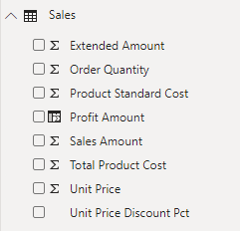
Describe measure types
Implicit measure
An Implicit measure is a model column that is summarized
Implicit measures:
Appear with the sigma symbol (∑) in the Fields pane
Are always numeric columns
Will summarize values when added to a visual
Notes:
In the Fields pane, a column that's shown with the sigma symbol (∑) indicates two facts:
It's a numeric column.
It will summarize column values when it is used in a visual (when added to a field well that supports summarization).
In the following image, notice that the Sales table includes only fields that can be summarized, including the Profit Amount calculated column.
As a data modeler, you can control if and how the column summarizes by setting the Summarization property to Don't summarize or to a specific aggregation function.
When you set the Summarization property to Don't summarize, the sigma symbol will no longer show next to the column in the Fields pane.
Calendar Year is often a numeric column to disable summarization

Slide 86
Describe measure types
Implicit measure (continued)
Benefits:
Simple to use
Easy to learn
Less work as a data modeler
Limitations:
Easy to choose wrong default
Limited scenarios
Not visible to MDX
Notes:
Several benefits are associated with implicit measures. Implicit measures are simple concepts to learn and use, and they provide flexibility in the way that report authors visualize model data. Additionally, they mean less work for you as a data modeler because you don't have to create explicit calculation.
Implicit measures do have limitations. Despite setting an appropriate summarization method, report authors could choose to aggregate a column in unsuitable ways. For example, in the matrix visual, you could modify the aggregate function of Unit Price to Sum. (sum the individual unit price of products, not reflect Qty Sold)
The report visual obeys your configuration, but it has now produced a Sum of Unit Price column, which contains misleading data.
Limited Scenarios
The most significant limitation of implicit measures is that they only work for simple scenarios, meaning that they can only summarize column values that use a specific aggregation function.
Therefore, in situations when you need to calculate the ratio of each month's sales amount over the yearly sales amount, you'll need to produce an explicit measure by writing a Data Analysis Expressions (DAX) formula to achieve that more sophisticated requirement.
MDX
Implicit measures don't work when the model is queried by using Multidimensional Expressions (MDX).
This language expects explicit measures and can't summarize column data.
It's used when a Power BI dataset is queried by using Analyze in Excel or when a Power BI paginated report uses an MDX query that is generated by a graphical query designer.

Slide 87
Describe measure types
Explicit measure
An Explicit measure is a measure defined using DAX
Explicit measures:
Define a formula that returns a scalar—or single—value
Do not store values in the model
Cannot reference tables or columns directly
Notes:
https://docs.microsoft.com/en-us/learn/modules/dax-power-bi-add-measures/2-simple-measures
In the next example, you will add a measure to the Sales table. In the Fields pane, select the Sales table. To create a measure, in the Table Tools contextual ribbon, from inside the Calculations group, select New measure.
The measure definition adds the Revenue measure to the Sales table. It uses the SUM DAX function to sum the values of the Sales Amount column.
On the Measure tools contextual ribbon, inside the Formatting group, set the decimal places to 2
Tip: Immediately after you create a measure, set the formatting options to ensure well-presented and consistent values in all report visuals.
Now, add the Revenue measure to the matrix visual. Notice that it produces the same result as the Sales Amount implicit measure.
In the matrix visual, remove Sales Amount and Sum of Unit Price.
Next, you will create more measures. Create the Cost measure by using the following measure definition, and then set the format with two decimal places.
Create the Profit measure, and then set the format with two decimal places.
Notice that the Profit Amount column is a calculated column. This topic will be discussed later in this module.
Next, create the Quantity measure and format it as a whole number with the thousands separator
Create three unit price measures and then set the format of each with two decimal places.
Notice the different DAX aggregation functions that are used: MIN , MAX , and AVERAGE .
Now, hide the Unit Price column, which results in report authors losing their ability to summarize the column except by using your measures.
[Tip]
Adding measures and hiding columns is how you, the data modeler, can limit summarization options.
Next, create the following two measures, which count the number of orders and order lines.
Format both measures with zero decimal places. The COUNT DAX function counts the number of non-BLANK values in a column, while the DISTINCTCOUNT DAX function counts the number of distinct values in a column.
Because an order can have one or more order lines, the Sales Order column will have duplicate values.
A distinct count of values in this column will correctly count the number of orders.
Alternatively, you can choose the better way to write the Order Line Count measure. Instead of counting values in a column, it's semantically clearer to use the COUNTROWS DAX function. Unlike the previously introduced aggregation functions, which aggregate column values, the COUNTROWS function counts the number of rows for a table.

Slide 88
Describe measure types
Explicit measure » Compound measure
A Compound measure is an explicit measure that refers to other explicit measures
Profit = [Revenue] - [Cost]
Notes:
When a measure references one or more measures, it's known as a compound measure.
For this example, you will modify the Profit measure by using the following measure definition.
Format the measure with two decimal places.
Next, add the Profit measure to the matrix visual.
Now that your model provides a way to summarize profit, you can delete the Profit Amount calculated column.
By removing this calculated column, you've optimized the data model.
It results in a decreased data model size and shorter data refreshes.
The Profit Amount calculated column wasn't required because the Profit measure can directly produce the required result.

Slide 89
Quick Measures
Power BI Desktop supports creating Quick Measures
Benefits:
Quick and easy
Common calculation templates are available
Automatically creates the DAX expression
No need to understand any DAX
Once created, they are like any other explicit measure
To modify the measure, simply edit the formula
Notes:
Microsoft Power BI Desktop includes a feature named Quick Measures .
This feature helps you to quickly perform common, powerful calculations by generating the DAX expression for you.
Many categories of calculations and ways to modify each calculation are available to fit your needs.
Moreover, you are able to see the DAX that's generated by the quick measure and use it to jumpstart or expand your DAX knowledge.

Slide 90
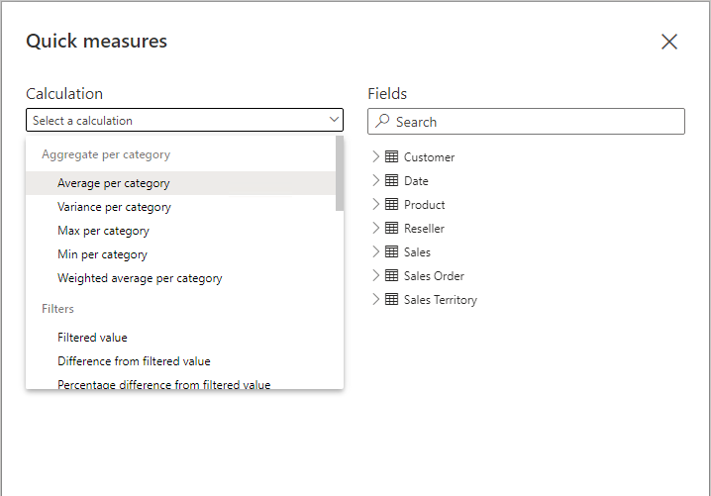
Quick Measures
Example
Notes:
This slide provides a screenshot of the Quick Measures window.

Slide 91
Calculated columns and measures
There are differences between calculated column and measure
 | Columns | Measures
Purpose | Extend table | Summarize model data
Evaluation | Row context at data refresh-time | Filter context at query-time
Storage | Stores value in each table row | Never stores value
Visual use | Filter, group, or summarize | Designed to summarize
Notes:
DAX beginners often experience a degree of confusion about calculated columns and measures.
The following section reviews the similarities and differences between both.
Regarding similarities between calculated columns and measures, both are:
Calculations that you can add to your data model.
Defined by using a DAX formula.
Referenced in DAX formulas by enclosing their names within square brackets.
The areas where calculated columns and measures differ include:
Purpose -
Calculated columns extend a table with a new column, while measures define how to summarize model data.
Evaluation -
Calculated columns are evaluated by using row context at data refresh time, while measures are evaluated by using filter context at query time.
Filter context is introduced in a later module; it's an important topic to understand and master so that you can achieve sophisticated summarizations.
Storage -
Calculated columns (in Import storage mode tables) store a value for each row in the table, but a measure never stores values in the model.
Visual use -
Calculated columns (like any column) can be used to filter, group, or summarize (as an implicit measure), whereas measures are designed to summarize.

Slide 92
Lab 4
Add measures to Power BI Desktop models
Notes:
Students will use the lab document to complete the lab.

Slide 93
Power BI DAX in a Day
Knowledge Check 01
https://aka.ms/DAXIADKnowCheck04
Notes:
For instructor, option 01 is to use the link above for the knowledge check questions
Option 02 is to use the Knowledge check in the appendix to the slides

Slide 94
Resources
Learn: Add measures to Power BI Desktop models
https://docs.microsoft.com/learn/modules/dax-power-bi-add-measures/

Slide 95
Questions?

Slide 96
Power BI DAX in a Day
Module 05
Use DAX Iterator Functions

Slide 97
Module outline
05: Integrate Content with the Power BI Client APIs
Describe iterator functions
Use aggregation iterator functions
Calculate ranks
Notes:
This module introduces and describes the family of iterator functions. It explains what they do and how to use them. Calculations can include custom aggregation, ranking, and concatenation.

Slide 98
Describe iterator functions
Iterator functions enumerate all rows of given table and evaluate a given expression for each row
They provide flexibility over how calculations summarize data
All iterator functions require Table and Expression
The expression must return scalar or single value
Iterator functions are easily identified by the appended “X”
For example:
Common aggregation: SUMX, AVERAGEX, COUNTX, MINX, and MAXX
Special: CONCATENATEX, and RANKX
Notes:
Data Analysis Expressions (DAX) include a set of functions known as iterator functions.
Iterator functions enumerate all rows of a given table and evaluate a given expression for each row. They provide you with flexibility and control over how your model calculations will summarize data.
By now, you're familiar with single-column summarization functions, including SUM, COUNT, MIN, MAX, and others. Each of these functions has an equivalent iterator function that's identified by the "X" suffix, such as SUMX, COUNTX, MINX, MAXX, and others.
Additionally, specialized iterator functions exist that perform filtering, ranking, semi-additive calculations over time, and more.
Characteristic of all iterator functions, you must pass in a table and an expression. The table can be a model table reference or an expression that returns a table object. The expression must evaluate to a scalar value.

Slide 99
Describe iterator functions
Example
Measure = SUMX( <Table>, <Expression> )
Notes:
This is what the signature of a common iterator function (SUMX) looks like.

Slide 100
Describe iterator functions
Example
Revenue = SUMX( Sales, Sales[Order Quantity] * Sales[Unit Price] )
Notes:
Now, consider the example of the Revenue measure. It iterates each row of the Sales table (in filter context) and multiplies the Order Quantity column by the Unit Price column.
Finally, it sums all row calculations together to produce total revenue.

Slide 101
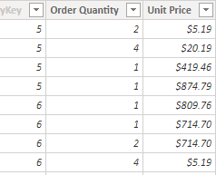
Describe iterator functions
Example
10.38
80.76
419.46
874.79
809.76
714.70
1,429.40
…
∑
208,202.17
Notes:
Use this slide to demonstrate how Power BI evaluates the Revenue measure.
[CLICK] once to commence showing the calculation method and result.

Slide 102
Describe iterator functions
Equivalent expressions
Revenue = SUM(Sales[Sales Amount])
Revenue = SUMX( Sales, Sales[Sales Amount] )
Notes:
Compare the two expressions, and then explain that they produce the same result.
In fact, Power BI will transpose the first example to become the second example. So, the SUM function is in fact a shorthand way to use an iterator function. It is the preferred way when aggregating the values of a single column.

Slide 103
Describe iterator functions
Evaluation context
It is important to understand how context works with iterator functions
Table is evaluated using filter context
Expression is evaluated using row context
Notes:
It's important to understand how context works with iterator functions. Because iterator functions enumerate over table rows, the expression is evaluated for each row in row context, similar to calculated column formulas.
The table is evaluated in filter context, so if you're using the previous Revenue measure definition example, if a report visual was filtered by fiscal year FY2020, then the Sales table would contain sales rows that were ordered in that year.
Filter context is described in the filter context module.
Tip:
When you are using iterator functions, make sure that you avoid using large tables (of rows) with expressions that use expansive DAX functions.
Some functions, like the SEARCH DAX function, which scans a text value that looks for specific characters or text, can result in slow implementation.
Also, the LOOKUPVALUE DAX function might result in a slow, row-by-row retrieval of values.
In this second case, use the RELATED DAX function instead, whenever possible.

Slide 104
Calculate ranks
The RANKX function is a special iterator function
It returns the ranking of a number in a list of numbers for each row in the table argument
RANKX ( <table> , <expression> [, <value>[, <order>[, <ties>]]]])
Notes:
The RANKX DAX function is a special iterator function you can use to calculate ranks.
Like all iterator functions, you must pass in a table and an expression. Optionally, you can pass in a rank value to find the order direction or to help you determine how to handle ranks when values are tied.

Slide 105
Calculate ranks
Order direction
Order direction is either ascending or descending
Revenue values use descending (favorable)
Rank customer complains ascending (unfavorable)
Default direction is descending
Notes:
Order direction is either ascending or descending.
When ranking something favorable, like revenue values, you're likely to use descending order so that the highest revenue will be ranked first.
When ranking something unfavorable, like customer complaints, you might use ascending order so that the lowest number of complaints will be ranked first.
When you don't pass in an order argument, the function will use descending order.

Slide 106
Calculate ranks
Handle ties
Either SKIP or DENSE
DENSE has no gaps in ranking sequence
For example: 1, 2, 2, 3, 4
SKIP adds gaps to ranking sequence
For example: 1, 2, 2, 4, 5
Default is to SKIP
Notes:
You can handle ties by skipping rank values or using dense ranking, which uses the next rank value after a tie. When you don't pass in a ties argument, the function will use skipped.

Slide 107
Lab 5
Use DAX iterator functions in Power BI Desktop models
Notes:
Students will use the lab document to complete the lab.

Slide 108
Power BI DAX in a Day
Knowledge Check 01
https://aka.ms/DAXIADKnowCheck05
Notes:
For instructor, option 01 is to use the link above for the knowledge check questions
Option 02 is to use the Knowledge check in the appendix to the slides

Slide 109
Resources
Learn: Use DAX iterator functions in Power BI Desktop models
https://docs.microsoft.com/learn/modules/dax-power-bi-iterator-functions/
Docs: RANKX
https://docs.microsoft.com/dax/rankx-function-dax

Slide 110
Questions?

Slide 111
Power BI DAX in a Day
Module 06
Modify Filter Context

Slide 112
Module outline
06: Modify Filter Context
Describe filter context
Use the CALCULATE function
Use filter modifier functions
Examine filter context
Perform context transition
Notes:
This module describes filter context and why it’s sometimes necessary to modify filter context. The main topic is the CALCULATE function.

Slide 113
Describe filter context
Filter context describes the filters applied during the evaluation of a measure or measure expression
Filters can be applied directly to columns
Filters can be applied indirectly via relationships
Notes:
Filter context describes the filters that are applied during the evaluation of a measure or measure expression.
Filters can be applied directly to columns, like a filter on the Fiscal Year column in the Date table for the value FY2020.
Additionally, filters can be applied indirectly, which happens when model relationships propagate filters to other tables.
For example, the Sales table receives a filter through its relationship with the Date table, filtering the Sales table rows to those with an OrderDateKey column value in FY2020.

Slide 114
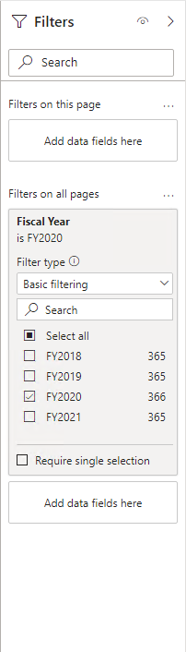
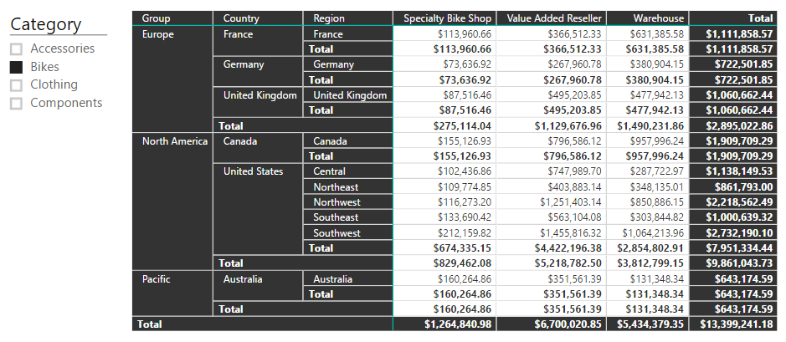
Describe filter context
Example
Notes:
Use this example to describe the filter context for the single cell in the matrix visual. There are seven [CLICK]s to complete the animation. With each click, describe the filter that applies to the value.

Slide 115
Describe filter context
Filter origin
Not all filters are applied at report design time
Report users can add or modify filters when interacting with the report by:
Modifying slicer selections
Modifying filters in the Filters pane
Selecting visual elements to cross-filter or cross-highlight other visuals
Notes:
Not all filters are applied at report design time.
Filters can be added when a report user interacts with the report.
They can modify filter settings in the Filters pane, and they can cross-filter or cross-highlight visuals by selecting visual elements like columns, bars, or pie chart segments.
These interactions apply additional filters to report page visuals (unless interactions have been disabled).
It's important to understand how filter context works.
It guides you in defining the correct formula for your calculations.
As you write more complex formulas, you'll identify times when you need to add, modify, or remove filters to achieve the desired result.

Slide 116
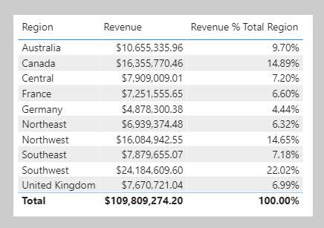
Describe filter context
Example
Notes:
Consider another example that requires your formula to modify the filter context. The objective is to produce a report visual that shows each sales region together with its revenue and revenue as a percentage of total revenue.
The Revenue % Total Region result is achieved by defining a measure expression that's the ratio of revenue divided by revenue for all regions.
Therefore, for Australia, the ratio is $10,655,335.96 divided by $109,809,274.20, which is 9.7 percent. The numerator expression doesn't need to modify filter context; it should use the current filter context (a visual that groups by region applies a filter for that region). The denominator expression, however, needs to remove any region filters to achieve the result for all regions.

Slide 117
Use the CALCULATE function
CALCULATE ( <expression> , [[<filter1>], <filter2>]…)
Notes:
You can use the CALCULATE DAX function to modify filter context in your formulas.
The syntax for the CALCULATE function is as follows:
The function requires passing in an expression that returns a scalar value and as many filters as you need.
The expression can be a measure (which is a named expression) or any expression that can be evaluated in filter context.
Filters can be Boolean expressions or table expressions.
It's also possible to pass in filter modification functions that provide additional control when you are modifying filter context.
When you have multiple filters, they're evaluated by using the AND logical operator, which means that all conditions must be TRUE at the same time.
Note:
The CALCULATETABLE DAX function performs exactly the same functionality as the CALCULATE function, except that it modifies the filter context that is applied to an expression that returns a table object.
In this module, the explanations and examples use the CALCULATE function, but keep in mind that these scenarios could also apply to the CALCULATETABLE function.

Slide 118
Use the CALCULATE function
Boolean expression filters
Boolean expression filters must evaluate as TRUE or FALSE
Each filter:
Can reference only a single column
Can not reference measures
Can not use functions that scan or return table
Notes:
A Boolean expression filter is an expression that evaluates to TRUE or FALSE.
Boolean filters must abide by the following rules:
They can reference only a single column
They cannot reference measures
They cannot use functions that scan or return a table that includes aggregation functions like SUM

Slide 119
Use the CALCULATE function
Boolean expression filters » Example
Revenue Red = CALCULATE( [Revenue], 'Product'[Color] = "Red" )
Notes:
In this example, you will create a measure. First, download and open the Adventure Works DW 2020 M06.pbix file.
Then, add the following measure definition that filters the Revenue measure by using a Boolean expression filter for red products.

Slide 120
Use the CALCULATE function
Boolean expression filters » Example (Continued)
Revenue Red = CALCULATE([Revenue], 'Product'[Color] = "Red")
Revenue Red = CALCULATE( [Revenue],
FILTER(
'Product', 'Product'[Color] = "Red" )
)
Notes:
All filter expressions that are passed in to the CALCULATE function are table filter expressions.
A Boolean filter expression is a shorthand notation to improve the writing and reading experience.
Internally, Microsoft Power BI translates Boolean filter expressions to table filter expressions, which is how it translates your Revenue Red measure definition.
The top example is internally re-written to be the same as the bottom expression

Slide 121
Use the CALCULATE function
Table expression filters
Table expression filters apply a table object as a filter
Each filter:
Can be a reference to model table
Can be a DAX function that returns a table object
It is common to use the FILTER function to create filters
Notes:
A table expression filter applies a table object as a filter.
It could be a reference to a model table; however, it's likely a DAX function that returns a table object.
Commonly, you'll use the FILTER DAX function to apply complex filter conditions, including those that can't be defined by a Boolean filter expression.
The FILTER function is classed as an iterator function, and so you would pass in a table, or table expression, and an expression to evaluate for each row of that table.
The FILTER function returns a table object with exactly the same structure as one that the table passed in.
Its rows are a subset of those rows that were passed in, meaning the rows where the expression evaluated as TRUE.

Slide 122
Use the CALCULATE function
Table expression filters » Example
Revenue High Margin Products = CALCULATE( [Revenue], FILTER(
'Product',
'Product'[List Price] > 'Product'[Standard Cost] * 2 )
)
Notes:
In this example, you will create a measure. First, download and open the Adventure Works DW 2020 M06.pbix file.
Then, add the following sure. In this example, the FILTER function filters all rows of the Product table that are in filter context. Each row for a product where its list price exceeds double its standard cost is displayed as a row of the filtered table. Therefore, the Revenue measure is evaluated for all products that are returned by the FILTER function

Slide 123
Use the CALCULATE function
Table filter columns » Filter behavior
If columns are not in filter context, new filters are added to filter context
If columns already in filter context, existing filters are overwritten
Notes:
Two possible standard outcomes occur when you add filter expressions to the CALCULATE function:
If the columns (or tables) aren't in filter context, then new filters will be added to the filter context to evaluate the CALCULATE expression.
If the columns (or tables) are already in filter context, the existing filters will be overwritten by the new filters to evaluate the CALCULATE expression.

Slide 124
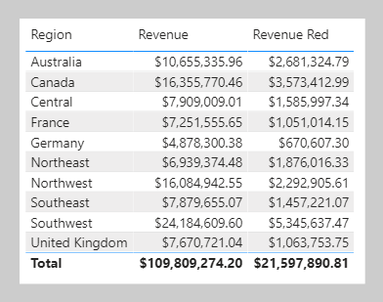
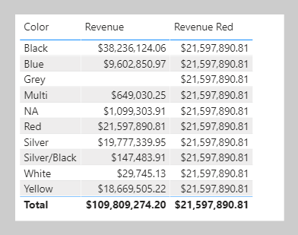
Modify filter context
Table filter columns » Filter behavior » Example
New filter added
Existing filter overwritten
Notes:
The following examples show how adding filter expressions to the CALCULATE function works.
As in the previous activity, the Revenue Red measure was added to a table visual that groups by region and displays revenue. Because no filter is applied on the Color column in the Product table, the evaluation of the measure adds a new filter to filter context. In the first row, the value of $2,681,324.79 is for red products that were sold in the Australian region.
In the second table visual, the first column of the table visual is switched from Region to Color. It produces a different result because the Color column in the Product table is now in filter context. The Revenue Red measure formula evaluates the Revenue measure by adding a filter on the Color column (to red) in the Product table.
Consequently, in this visual that groups by color, the measure formula overwrites the filter context with a new filter. This result might or might not be what you want.
The next unit introduces the KEEPFILTERS DAX function, which is a filter modification function that you can use to preserve filters rather than overwrite them.

Slide 125
Use filter modifier functions
When using CALCULATE, it is possible to pass in filter modification functions
Filter modifier functions include:
REMOVEFILTERS – Remove filters from all tables, a single table or column(s)
ALL – Remove filters from a single table or column(s)
ALLEXCEPT – Remove filters from all columns of a single table, except those explicitly passed in
ALLNONBLANKROW – From the parent table of a relationship, returns all rows but the blank row, or all distinct values of a column but the blank row, and disregards any context filters that might exist
Notes:
When using the CALCULATE function, you can pass in filter modification functions, which allow you to accomplish more than adding filters.
The REMOVEFILTERS function is relatively new. In previous versions of DAX, you removed filters by using the ALL DAX function or variants including the ALLEXCEPT and the ALLNOBLANKROW DAX functions.
These functions behave as both filter modifiers and as functions that return table objects of distinct values. These functions are mentioned now because you're likely to find documentation and formula examples that remove filters by using them.

Slide 126
Use filter modifier functions
Use inactive relationships
Use the USERRELATIONSHIP function to make an inactive relationship active during the evaluation of the CALCULATE function
Revenue Shipped = CALCULATE( [Revenue], USERELATIONSHIP(
'Date'[DateKey],
'Sales'[ShipDateKey]
) )
Notes:
An inactive model relationship can only propagate filters when the USERELATIONSHIP DAX function is passed as a filter expression to the CALCULATE function.
When you use this function to engage an inactive relationship, the active relationship will automatically become inactive.
Review an example of a measure definition that uses an inactive relationship to calculate the Revenue measure by shipped dates:

Slide 127
Use filter modifier functions
Modify relationship behavior
Use CROSSFILTER to modify relationship behavior
Modify filter direction(s)
Disable filters
Notes:
You can modify the model relationship behavior when an expression is evaluated by passing the CROSSFILTER DAX function as a filter expression to the CALCULATE function.
It's an advanced capability. The CROSSFILTER function can modify filter directions (from both to single or from single to both) and even disable a relationship.

Slide 128
Examine filter context
It is possible to examine filter context by using certain DAX functions:
VALUES
HASONEVALUE
SELECTEDVALUE
ISFILTERED
ISCROSSFILTERED
ISINSCOPE
Notes:
It is possible to examine filter context by using certain DAX functions:
VALUES
HASONEVALUE
SELECTEDVALUE
ISFILTERED
ISCROSSFILTERED
ISINSCOPE

Slide 129
Examine filter context
VALUES function
Use the VALUES function determines what values are in filter context
VALUES ( <TableNameOrColumnName> )
Use the HASONEVALUE function to determine if the context for a specific column has been filtered down to one distinct value only
Use the SELECTEDVALUE function to return the value when one value is in context
Notes:
The VALUES DAX function lets your formulas determine what values are in filter context.
The VALUES function syntax is as follows:
The function requires passing in a table reference or a column reference.
When you pass in a table reference, it returns a table object with the same columns that contain rows for what's in filter context.
When you pass in a column reference, it returns a single-column table of unique values that are in filter context.
The function always returns a table object and it's possible for a table to contain multiple rows.
Therefore, to test whether a specific value is in filter context, your formula must first test that the VALUES function returns a single row.
Two functions can help you accomplish this task:
the HASONEVALUE and
the SELECTEDVALUE DAX functions.
The HASONEVALUE function returns TRUE when a given column reference has been filtered down to a single value.
The SELECTEDVALUE function simplifies the task of determining what a single value could be. When the function is passed a column reference, it'll return a single value, or when more than one value is in filter context, it'll return BLANK (or an alternate value that you pass to the function).

Slide 130
Examine filter context
Other functions
ISFILTERED - Returns TRUE when a passed-in column reference is directly filtered
ISCROSSFILTERED - Returns TRUE when a passed-in column reference is indirectly filtered
ISINSCOPE - Returns TRUE when a passed-in column reference is the level in a hierarchy of levels
Notes:
Three other functions that you can use to test filter state are:
ISFITLERED DAX function - Returns TRUE when a passed-in column reference is directly filtered.
ISCROSSFILTERED DAX function - Returns TRUE when a passed-in column reference is indirectly filtered.
A column is cross-filtered when a filter that is applied to another column in the same table, or in a related table, affects the reference column by filtering it.
ISINSCOPE DAX function - Returns TRUE when a passed-in column reference is the level in a hierarchy of levels.

Slide 131
Perform context transition
When a measure or measure expression is evaluated within row context, it undergoes context transition
In this case, the CALCULATE function applies row context values as filters
It occurs when:
A calculated column formula uses a measure
An expression in an iterator function is evaluated
Notes:
What happens when a measure or measure expression is evaluated within row context?
This scenario can happen in a calculated column formula or when an expression in an iterator function is evaluated.

Slide 132
Perform context transition
Measures used by an expression that is evaluated in row context automatically undergo context transition
To force context transition, wrap a measure expression inside the CALCULATE function—it does need to pass in any filters
Notes:
Measures used by an expression that is evaluated in row context automatically undergo context transition.
To force context transition, wrap a measure expression inside the CALCULATE function—it does need to pass in any filters.

Slide 133
Power BI DAX in a Day
Knowledge Check 01
https://aka.ms/DAXIADKnowCheck06
Notes:
For instructor, option 01 is to use the link above for the knowledge check questions
Option 02 is to use the Knowledge check in the appendix to the slides

Slide 134
Resources
Learn: Modify DAX filter context in Power BI Desktop models
https://docs.microsoft.com/learn/modules/dax-power-bi-modify-filter/
Docs: DAX overview (context)
https://docs.microsoft.com/dax/dax-overview#context
Docs: CALCULATE
https://docs.microsoft.com/dax/calculate-function-dax

Slide 135
Questions?

Slide 136
Power BI DAX in a Day
Module 07
Use DAX Time Intelligence Functions

Slide 137
Module outline
07: Use DAX Time Intelligence Functions
Define Time Intelligence
Use Time Intelligence functions
Notes:
This module defines Time Intelligence and provides common use cases.

Slide 138
Define Time Intelligence
Time Intelligence relates to calculations over dates, months, quarters, or years
It involves modifying the filter context for date filters
The model requires a date table
The date table can be created using the CALENDAR or CALENDARAUTO functions
Notes:
Time intelligence relates to calculations over time. Specifically, it relates to calculations over dates, months, quarters, or years, and possibly time.
Note: Rarely would you need to calculate over time in the sense of hours, minutes, or seconds.
In Data Analysis Expressions (DAX) calculations, time intelligence means modifying the filter context for date filters.

Slide 139
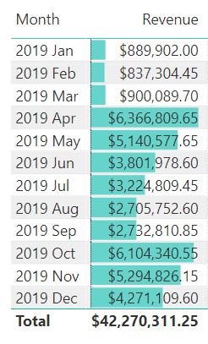
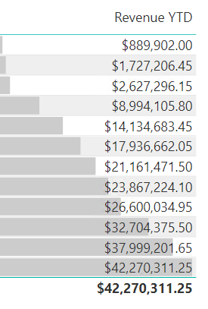
Define Time Intelligence
Example
Notes:
Here’s an example. It’s easy to show monthly revenue: group by month and sum the revenue column.
[CLICK] By applying Time Intelligence, a measure can be defined to compute the accumulation of revenue over the year. This type of calculation is known as a year-to-date (YTD) calculation.
Describe that the accumulation of revenue over the year is a manipulation of the date filter. Consider the YTD value for 2019 Feb. It isn’t the sum of revenue in Feb. Rather, it’s the sum of revenue from the beginning of the year (2019 Jan) until 2019 Feb.

Slide 140
Define Time Intelligence
Date table » Requirements
The date table must have a Date (or Date/time) column
The Date column:
Must contain unique values
Must not contain BLANKS
Must not have missing dates (gaps)
Must span full years (financial or traditional)
The date table should be marked as a date table
Notes:
The date table (or tables) must meet certain requirements. The date table should be marked as a date table (described next).

Slide 141
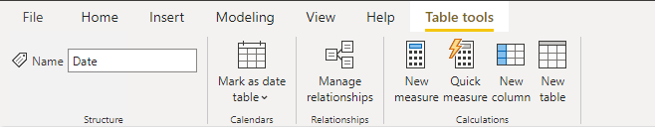
Define Time Intelligence
Date table » Marking
To use the Time Intelligence functions, a table must be marked as a date table
It also allows the model tables to use a non-date type key
The date key can be in ISO format, for example 20210630
Multiple model tables can be marked as date tables
Notes:
To use the Time Intelligence functions, a table must be marked as a date table.
Multiple model tables can be marked as date tables.
For more information, see https://docs.microsoft.com/power-bi/guidance/model-date-tables

Slide 142
Use Time Intelligence functions
DAX has many inbuilt Time Intelligence functions
For example, TOTALYTD and PREVIOUSYEAR
It is possible to replace them using CALCUALTE
However, that requires more work and could be slower for Power BI to evaluate
Notes:
DAX includes several time intelligence functions to simplify the task of modifying date filter context. You could write many of these intelligence formulas by using a CALCULATE function that modifies date filters, but that would create more work.
Note:
Many DAX time intelligence functions are concerned with standard date periods, specifically years, quarters, and months.
If you have irregular time periods (for example, financial months that begin mid-way through the calendar month), or you need to work with weeks or time periods (hours, minutes, and so on), the DAX time intelligence functions won't be helpful.
Instead, you'll need to use the CALCULATE function and pass in hand-crafted date or time filters.

Slide 143
Use Time Intelligence functions
Common use cases
Cumulative totals
Period comparisons
New customer orders by month
Stock on-hand value
Notes:
Time intelligence calculations modify date filter contexts.
They can help you answer these time-related questions:
What's the accumulation of revenue for the year, quarter, or month?
What revenue was produced for the same period last year?
What growth in revenue has been achieved over the same period last year?
How many new customers made their first order in each month?
What's the inventory stock on-hand value for the company's products?

Slide 144
Use Time Intelligence functions
Summarization over time
DATESYTD – Returns a single-column table of dates
TOTALYTD – Evaluates expression for year-to-date (YTD)
DATESBETWEEN – Returns single-column table with range dates
DATESINPERIOD – Returns single-column table with range of dates
Notes:
One group of DAX time intelligence functions is concerned with summarizations over time:
DATESYTD DAX function - Returns a single-column table that contains dates for the year-to-date (YTD) in the current filter context.
This group also includes the DATESMTD and DATESQTD DAX functions for month-to-date (MTD) and quarter-to-date (QTD).
You can pass these functions as filters into the CALCULATE DAX function.
TOTALYTD DAX function - Evaluates an expression for YTD in the current filter context.
The equivalent QTD and MTD DAX functions of TOTALQTD and TOTALMTD are also included.
DATESBETWEEN DAX function - Returns a table that contains a column of dates that begins with a given start date and continues until a given end date.
DATESINPERIOD DAX function - Returns a table that contains a column of dates that begins with a given start date and continues for the specified number of intervals.
Note:
While the TOTALYTD function is simple to use, you are limited to passing in one filter expression.
If you need to apply multiple filter expressions, use the CALCULATE function and then pass the DATESYTD function in as one of the filter expressions.

Slide 145
Use Time Intelligence functions
Shifting time periods
DATEADD – Returns single-column table of dates shifted by interval
PARALLELPERIOD – Returns single-column table of parallel dates
SAMEPERIODLASTYEAR – Returns dates shifted back one year
Many others – NEXTDAY, NEXTMONTH, NEXTQUARTER, NEXTYEAR, PREVDAY, PREVMONTH, PREVQUARTER ,PREVYEAR
Notes:
Another group of DAX time intelligence functions is concerned with shifting time periods:
DATEADD DAX function - Returns a table that contains a column of dates, shifted either forward or backward in time by the specified number of intervals from the dates in the current filter context.
PARALLELPERIOD DAX function - Returns a table that contains a column of dates that represents a period that is parallel to the dates in the specified dates column, in the current filter context, with the dates shifted a number of intervals either forward in time or back in time.
SAMEPERIODLASTYEAR DAX function - Returns a table that contains a column of dates that are shifted one year back in time from the dates in the specified dates column, in the current filter context.
Many helper DAX functions for navigating backward or forward for specific time periods, all of which returns a table of dates. These helper functions include NEXTDAY , NEXTMONTH , NEXTQUARTER , NEXTYEAR , and PREVIOUSDAY , PREVIOUSMONTH , PREVIOUSQUARTER , and PREVIOUSYEAR .

Slide 146
Use Time Intelligence functions
Return a single date
FIRSTDATE – Returns first date in current filter context
LASTDATE – Returns last date in current filter context
Notes:
Other DAX time intelligence functions exist that are concerned with returning a single date.
You'll learn about these functions by applying them in two different scenarios.
The FIRSTDATE and the LASTDATE DAX functions return the first and last date in the current filter context for the specified column of dates.

Slide 147
Use Time Intelligence functions
Snapshot calculations
Inventory stock levels or account balances
Useful when tables store snapshot of values
For example, inventory stock levels or account balances
Calculations can summarize across any dimension except date
For example, stock level counts by product category works, but not by date range
Notes:
Occasionally, fact data is stored as snapshots in time. Common examples include inventory stock levels or account balances. A snapshot of values is loaded into the table on a periodic basis.
When summarizing snapshot values (like inventory stock levels), you can summarize values across any dimension except date.
Adding stock level counts across product categories produces a meaningful summary but adding stock level counts across dates does not. Adding yesterday's stock level to today's stock level isn't a useful operation to perform (unless you want to average that result).
When you are summarizing snapshot tables, measure formulas can rely on DAX time intelligence functions to enforce a single date filter.

Slide 148
Use Time Intelligence functions
Snapshot calculations » Functions
LASTNONBLANK – Returns the last date that produces a non-BLANK result
FIRSTNONBLANK – Returns the first date that produces a non-BLANK result
LASTNONBLANKVALUE – Returns the value of the last date that produces a non-BLANK result
FIRSTNONBLANKVALUE – Returns the value of the first date that produces a non-BLANK result
Notes:
The LASTNONBLANK function is an iterator function.
It returns the last date that produces a non-BLANK result.
It achieves this result by iterating through all dates in filter context in descending chronological order.
(Conversely, the FIRSTNONBLANK iterates in ascending chronological order.)
For each date, it evaluates the passed in expression.
When it encounters a non-BLANK result, the function returns the date.
That date is then used to filter the CALCULATE function.
NOTE:
The LASTNONBLANK function evaluates its expression in row context.
The CALCULATE function must be used to transition the row context to filter context to correctly evaluate the expression.

Slide 149
Lab 7
Use DAX Time Intelligence functions in Power BI Desktop models
Notes:
Students will use the lab document to complete the lab.

Slide 150
Power BI DAX in a Day
Knowledge Check 01
https://aka.ms/DAXIADKnowCheck07
Notes:
For instructor, option 01 is to use the link above for the knowledge check questions
Option 02 is to use the Knowledge check in the appendix to the slides

Slide 151
Resources
Docs: Time intelligence functions
https://docs.microsoft.com/dax/time-intelligence-functions-dax
Learn: Use DAX time intelligence functions in Power BI Desktop models
https://docs.microsoft.com/dax/time-intelligence-functions-dax
Docs: Create date tables in Power BI Desktop
https://docs.microsoft.com/power-bi/guidance/model-date-tables

Slide 152
Questions?

Slide 153
Resources
Learn: Use DAX in Power BI Desktop
This learning path introduces Data Analysis Expressions (DAX) and provides you with foundational skills required to enhance data models with calculations
https://docs.microsoft.com/learn/paths/dax-power-bi/
Docs: Data Analysis Expressions (DAX) Reference
https://docs.microsoft.com/dax/
DAX videos
https://docs.microsoft.com/dax/dax-learn-videos

Slide 154
Post training survey
Please complete post training survey to help us gather feedback
https://aka.ms/DAXIADSurvey

Slide 156
Power BI DAX in a Day
Appendix 01
Knowledge Checks by Modules with answers

Slide 157
Knowledge check 01A
In a Power BI Desktop model design, which type of object enforces row-level security?
Table
Column
Measure
Role
Notes:
Roles enforce Row-level security (RLS).

Slide 158
Knowledge check 01B
Which of the following statements is correct regarding a star schema design?
Fact tables store accumulations of business events
Fact tables store accumulations of business entities
Fact tables must have a unique column
Notes:
Fact tables store accumulations of business events.

Slide 159
Knowledge check 01C
In what order does an analytic query implement its phases?
Filter ► Group ► Summarize
Group ► Filter ► Summarize
Summarize ► Filter ► Group
Notes:
An analytic query implements is phase in order of: Filter > Group > Summarize.

Slide 160
Knowledge check 02A
You're using Power BI Desktop to develop a model. It has a table named Sales, which includes a column named CustomerKey. In reports, you need a calculation to show the number of different customers who have placed orders. What type of DAX calculation will you add to the Sales table?
Calculated table
Calculated column
Computed column
Measure
Notes:
https://docs.microsoft.com/en-us/learn/modules/dax-power-bi-write-formulas/7-check
You can add a measure to the Sales table by using the DISTINCTCOUNT DAX function

Slide 161
Knowledge check 02B
You're using Power BI Desktop to develop a model. It has a table named Customer, which includes a column named DateOfBirth. In reports, you need to group customers by current age. What type of DAX calculation will you add to the Customer table?
Calculated table
Calculated column
Computed column
Measure
Notes:
https://docs.microsoft.com/en-us/learn/modules/dax-power-bi-write-formulas/7-check
A calculated column can store the current age for each customer. This column could then be used in reports to group customers by age.

Slide 162
Knowledge check 02C
You're using Power BI Desktop to develop a model. It has a table named Geography, which has two relationships to the Sales table. One relationship filters by customer region and the other filters by sales region. Report users need to filter or group Sales table data by either region. What type of DAX calculation will you add to the model?
Calculated table
Calculated column
Computed column
Measure
Notes:
https://docs.microsoft.com/en-us/learn/modules/dax-power-bi-write-formulas/7-check
A calculated column can store the current age for each customer. This column could then be used in reports to group customers by age.

Slide 163
Knowledge check 02D
You write a DAX formula that adds BLANK to the number 20. What will be the result?
The result will be zero (0)
The result will be 20
The result will be BLANK
The result will be NULL
Notes:
https://docs.microsoft.com/en-us/learn/modules/dax-power-bi-write-formulas/7-check
BLANK is converted to zero when added to a number

Slide 164
Knowledge check 03A
Which statement about calculated tables is true?
Calculated tables increase the storage size of the data model
Calculated tables are evaluated by using row context
Calculated tables are created in Power Query
Calculated tables cannot include calculated column
Notes:
https://docs.microsoft.com/en-us/learn/modules/dax-power-bi-add-calculated-tables/5-check
Calculated tables store data inside the model, and adding them results in a larger model size.

Slide 165
Knowledge check 03B
Which statement about calculated columns is true?
Calculated columns are created in the Power Query Editor window
Calculated column formulas are evaluated by using row context
Calculated column formulas can only reference columns from within their table
Calculated columns can't be related to non-calculated columns
Notes:
https://docs.microsoft.com/en-us/learn/modules/dax-power-bi-add-calculated-tables/5-check
Calculated column formulas are evaluated by using row context.

Slide 166
Knowledge check 03C
You're developing a Power BI desktop model that sources data from a Microsoft Azure SQL database. The database has an employee table that stores one row for each employee. Each row has a reference to the employee's manager, which is also a row in the employee table. You need to add several columns to the Employee table in your model to analyze payroll data within the organization hierarchy. Which technique will you use to add the columns?
Add persisted columns to a table by using T-SQL
Add column expressions in a view by using T-SQL
Add computed columns by using M
Add calculated columns by using DAX
Notes:
https://docs.microsoft.com/en-us/learn/modules/dax-power-bi-add-calculated-tables/5-check
You can use the DAX parent-child functions to naturalize the recursive (employee-manager) relationship into columns.

Slide 167
Knowledge check 04A
Which statement about measures is correct?
Measures store values in the data model
Measures must be added to the data model to achieve summarization
Measures can reference columns directly
Measures can reference other measures directly
Notes:
https://docs.ahttps://docs.microsoft.com/en-us/learn/modules/dax-power-bi-add-measures/6-check
Measures can reference other measures. It's known as a compound measure
microsoft.com/en-us/learn/modules/dax-power-bi-add-calculated-tables/5-check
Calculated tables store data inside the model, and adding them results in a larger model size.

Slide 168
Knowledge check 04B
Which DAX function can summarize a table?
SUM
AVERAGE
COUNTROWS
DISTINCTCOUNT
Notes:
https://docs.microsoft.com/en-us/learn/modules/dax-power-bi-add-measures/6-check
The COUNTROWS function summarizes a table by returning the number of rows.

Slide 169
Knowledge check 04C
Which of the following statements describing similarity of measures and calculated columns in an Import model is true?
They can achieve summarization of model data
They store values in the data model
They're evaluated during data refresh
They can be created by using quick calculations
Notes:
https://docs.microsoft.com/en-us/learn/modules/dax-power-bi-add-measures/6-check
A calculated column can be summarized (implicit measure) and a measure always achieves summarization.

Slide 170
Knowledge check 05A
An iterator function always includes at least two arguments.
What are they?
Column and expression
Table and expression
Measure and expression
Table and ranking
Notes:
https://docs.microsoft.com/en-us/learn/modules/dax-power-bi-iterator-functions/4-check An iterator function iterates over a table and evaluates an expression for each row of the table.

Slide 171
Knowledge check 05B
Which statement about DAX iterator functions is true?
When used to add values of the same column, the SUM function performs better than the SUMX function
When used to add values of the same column, the SUMX function performs better than the SUM function
Iterator functions iterate over tables and evaluate an expression for each table row
Iterator functions iterate over expressions and evaluate tables for each row
Notes:
https://docs.microsoft.com/en-us/learn/modules/dax-power-bi-iterator-functions/4-check Iterator functions iterate over tables and evaluate an expression for each table row.

Slide 172
Knowledge check 05C
You're developing a Power BI Desktop model. You need to create a measure formula by using the RANKX DAX function to rank students by their test results. The lowest rank should be assigned to the highest test result. Also, if multiple students achieve the same rank, the next student rank should follow on from the tied rank number. Which order and ties arguments should you pass to the RANKX function?
Order Ascending | Ties Skip
Order Ascending | Ties Dense
Order Descending | Ties Skip
Order Descending | Ties Dense
Notes:
https://docs.microsoft.com/en-us/learn/modules/dax-power-bi-iterator-functions/4-check The highest test result should be assigned the lowest rank. Therefore, the order argument must be Descending. Because no missing rank numbers should exist, the ties argument must be Dense.

Slide 173
Knowledge check 06A
Which type of model object is evaluated within a filter context?
Calculated column
Calculated table
Measure
Security role rule
Notes:
Measures (and measure expressions) are always evaluated in filter context.

Slide 174
Knowledge check 06B
Which DAX functions allows you to use an inactive relationship when evaluate a measure expression?
USERELATIONSHIP
CROSSFILTER
REMOVEFILTERS
ISCROSSFILTERED
Notes:
The USERELATIONSHIP function is a filter modifier function that can be pass in to the CALCULATE function. Its purpose is to engage an inactive relationship.

Slide 175
Knowledge check 06C
Which statement about the CALCULATE function is true?
You must pass in at least one filter argument
It modifies filter context to evaluate a given expression
It modifies row context to evaluate a given expression
It cannot be used by a calculated column formula
Notes:
The CALCULATE function modifies filter context by adding or removing filters, or modifying standard filter behavior

Slide 176
Knowledge check 07A
In the context of data model calculations, which statement best describes time intelligence?
Snapshot balance reporting
Filter context modifications involving a date table
Complex calculations involving time
Calculations involving hours, minutes, or seconds
Notes:
Time intelligence calculations modify date filter contexts.

Slide 177
Knowledge check 07B
You’re developing a data model in Power BI Desktop. You’ve just added a date table by using the CALENDARAUTO function. You’ve extended it with calculated columns, and you’ve related it to other model tables. What else must you do to ensure DAX time intelligence calculations work correctly?
Add time intelligence measures to the date table
Mark the date table
Add a fiscal hierarchy
Add a date column
Notes:
Time intelligence calculations modify date filter contexts.

Slide 178
Knowledge check 07C
You have a table that stores account balance snapshots for each date, excluding weekends. You need to ensure that your measure formula only filters by a single date. Also, if there’s no record on the last date of a time period, it should use the latest account balance.
Which DAX time intelligence function should you use?
FIRST
FIRSTNONBLANK
LAST
LASTNONBLANK
Notes:
The LASTNONBLANK function will return the last date in the filter context where there’s a snapshot record. This will achieve the objective.

